Slide 1


New to Country Segment Strategy
Team – Breaking Boundaries
Represented by
Arindam Chatterjee
Ashwini Sancheti
Paramgama Sikdar
Subhajit Pal
Shatadal Dey

Slide 2


People today are mobile and globally connected than ever before

Slide 3
Migrants contributed 9.4% of global GDP which is $6.7 trillion
Migrants sent ~ $600 billion in remittances in 2017
EU immigrants contribute $2300 more per year to UK than average British citizen
52% migrants plan to stay for more than 5 years

Slide 4
All of that makes the Expat segment a massive business potential

Slide 5

Meera has recently moved to UK

Slide 6

But she is not alone

Slide 7
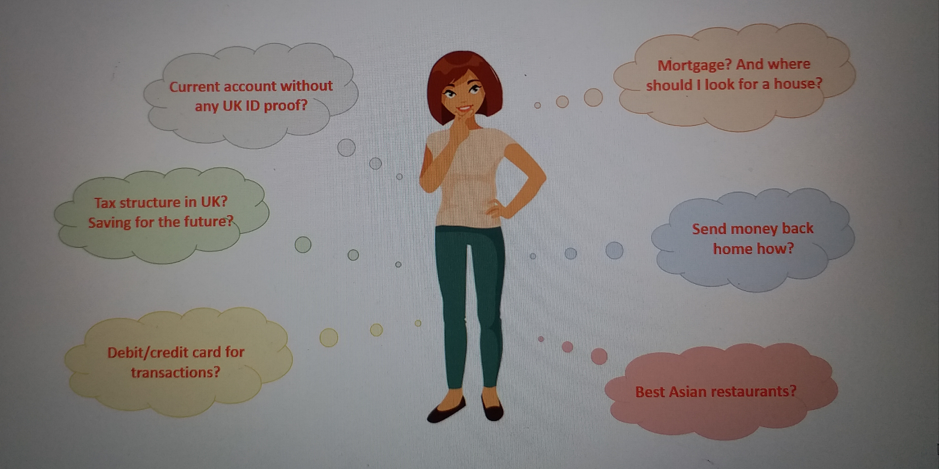
And she has a lot to worry about

Slide 8

There are many like her

Slide 9

HSBC can help customers like Meera with a host of innovative services and provide them a wonderful customer experience

Slide 10
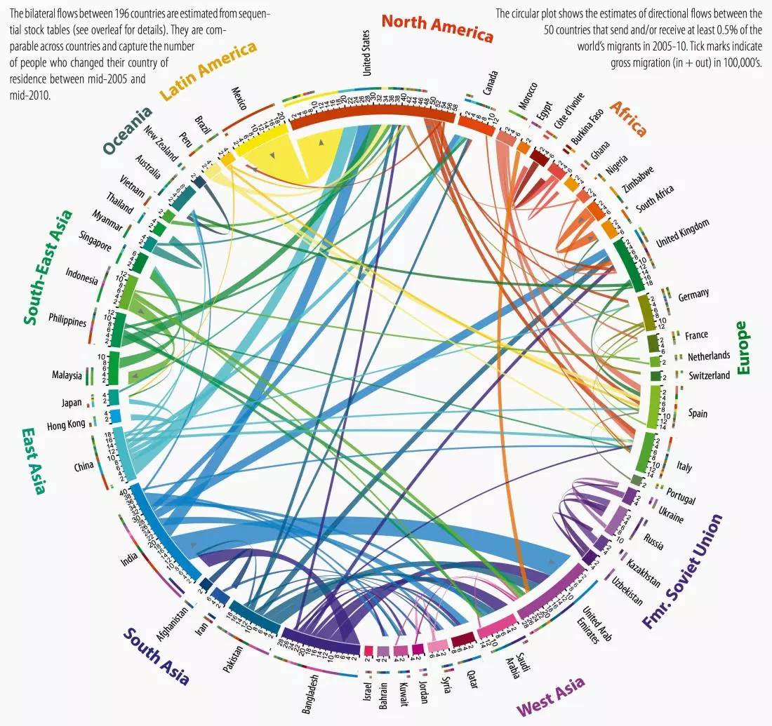
This is how the expat migration network looks like.
HSBC’s international network and the aspiration to become a mobile centred smart bank gives it a natural right to compete in this segment

Slide 11
Let us find out how….

